Slide 1

Description:
a decision tree representing the choices the Trojans could
have made when they encountered the Trojan horse.
Is it a wooden horse?
YES
NO
Does It have wheels?
It’s probably a horse that is alive that you can ride back to Troy.
YES
NO
Does it have suspicious noises coming from inside it?
Go to slide#2
YES
Go to slide#3
Let send a message to the Greeks telling them they forgot their stuff.

Slide 2
Can you make some sort machine that can pull it back to Troy?
YES
NO
Do you want to bring it inside the city of Troy so we can celebrate our victory!
Probably should just go home because that would be a lot to work to just drag it to the city.
YES
NO
Oops it turns out that the enemy was hiding inside the wooden horse. As a result they open the gates and took control over the city of Troy hope no one ever writes about this embarrassing story.
Dude that was such a party foul and as a result you are lame forever bro.

Slide 3
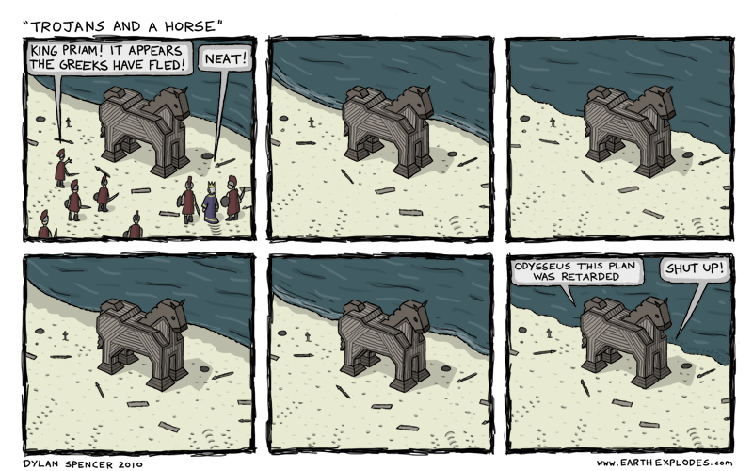
Congratulations you found the Greek elite force inside the wooden horse.
Leave it! Don’t bring it inside the gates!

